Slide 1
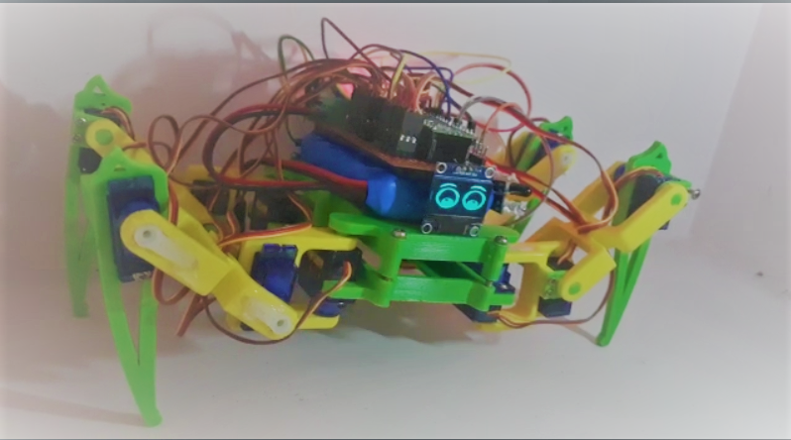

BOOMER
An Open Source Quadruped Pet Robot

Slide 2

Akhil P Jacob
Robotics Research Engineer and Enthusiast
Electronics and Communication Engineer
Coordinate Robot Guidance System
Low cost Robotics and Solutions
Developed HL Engine
Robotic Arms
Mentor at Kerala Police Academy, Robo cup Jr 2019, NASA Space App challenge 2021 represented UAE.

Slide 3

Why Boomer ?

Slide 4
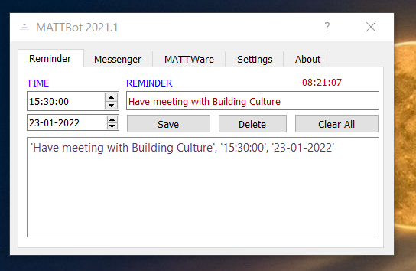
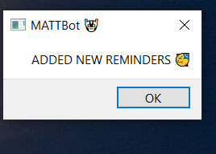
MATT Bot 2021 & 2020
Virtual Technical Assistant for programmers.
Reminders
Messengers with end to end encryption
MATT Ware to control Household electrical equipment's like fan and light with brightness control over Wi-Fi.
Personalize wishes and Reminders to take water, food and tablets regularly.
Github:https://github.com/HLRobotics/MATTBot_2021_Windows.git
(Executable Windows)

Slide 5

Open Source Stress Buster
Reduce Stress
Aid Mental health
Owning a Digital Pet in the workbench without spoiling table
Support at work
Physical Presence

Slide 6
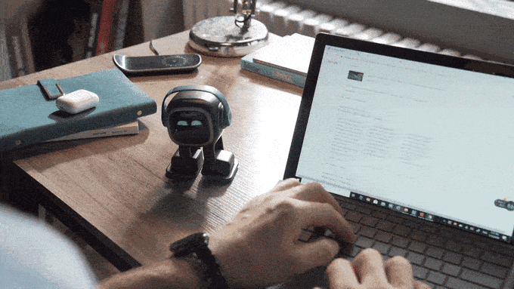
Currently Available in Market
EMO

Slide 7

Problem Statements
Open Source
Cheap and Easily Available components
Simple Algorithms
Cheap Communication Protocols
Interactive
ARM based development board
Micro python supported
Simple Environmental Awareness sensors

Slide 8
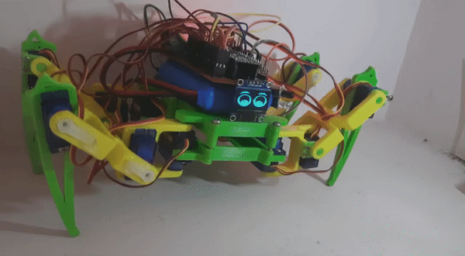
Solution

Slide 9
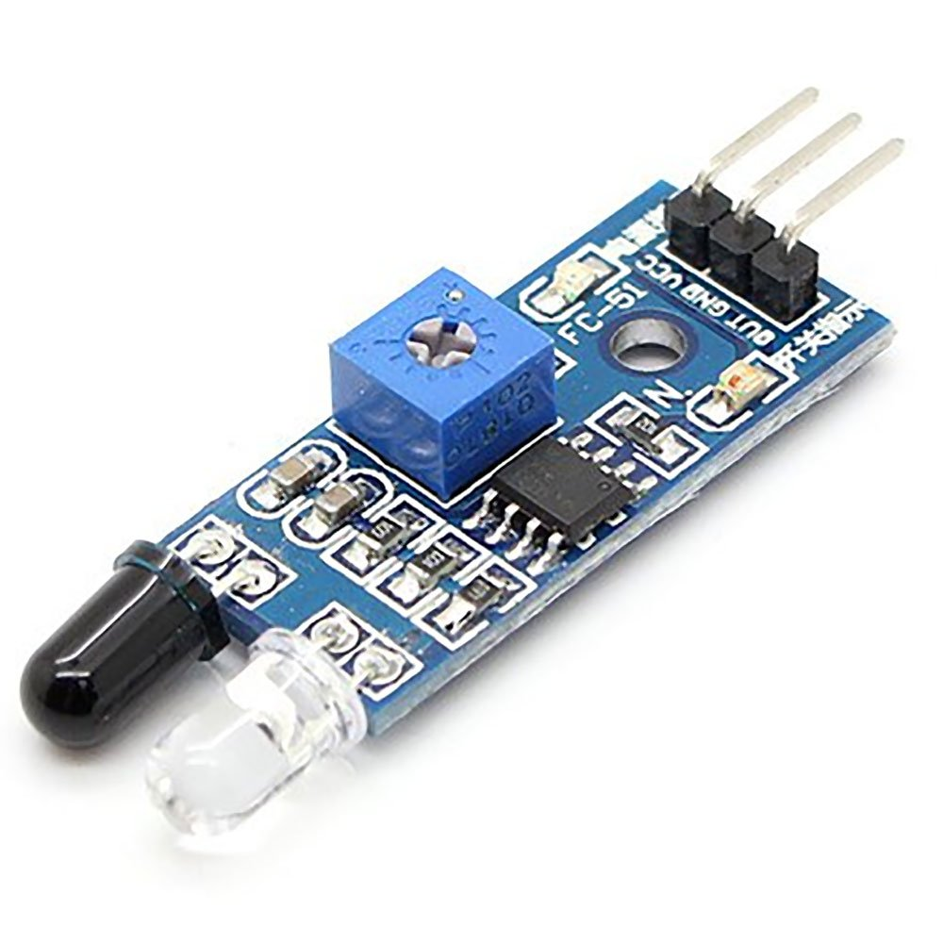
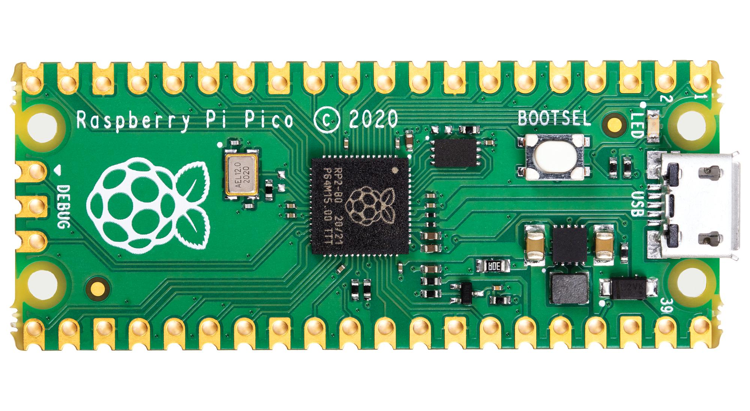
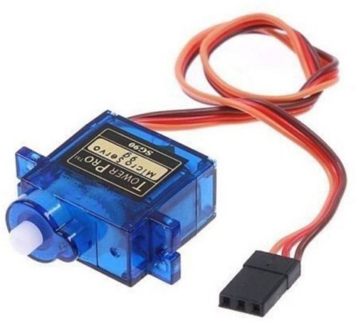
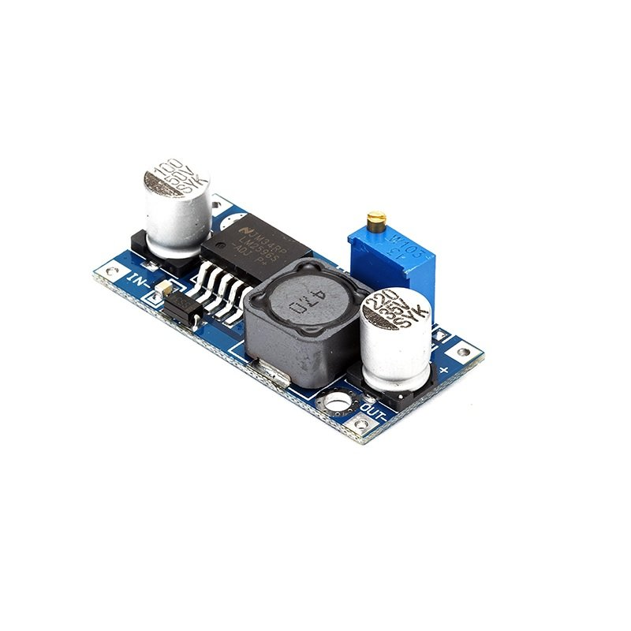
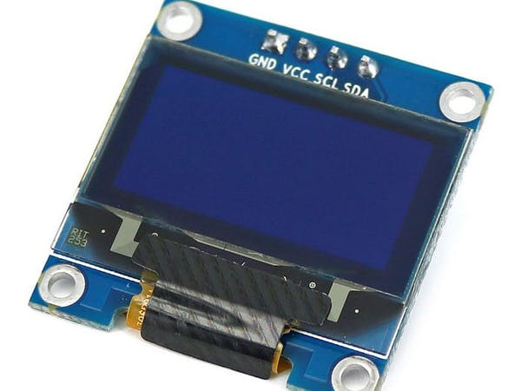
Components Used

Slide 10

Emotion Detection
Sad
Happy
Anger
Anxiety
Agony
Excited
https://github.com/HLRobotics/HL_Engine.git

Slide 11
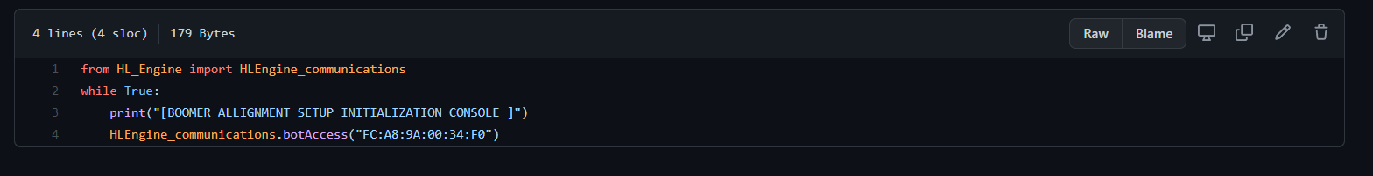
Linux BT Communication HL_Engine

Slide 12
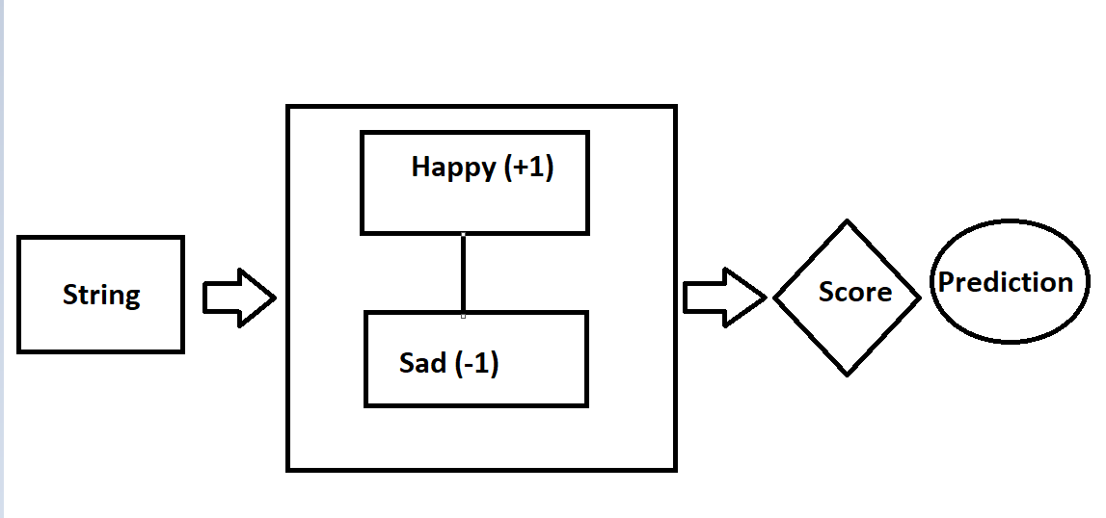
Algorithm

Slide 13
GitHub Repos
https://github.com/HLRobotics/HL_Engine.git
https://github.com/HLRobotics/MATTBot_2021
https://github.com/HLRobotics/BOOMER

Slide 14
Thanks (contact:+91-9656659490)

